Slide 1



Slide 2
Agenda
Change Management Process Overview.
What do we mean by a change ?
Process Flow.
CR phases.
Zooming in some Mandatory Fields
      Impact
      Urgency
      Priority
      Risk
What’s Required from Your side ?
Questions.

Slide 3



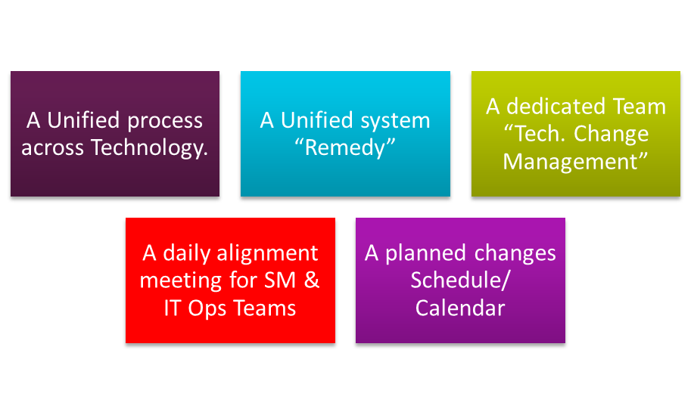

Change Management Process Overview
aximize successful implementation.
inimize the impact of changes
aintain balance between need for Change & its impact.
And to Achieve this

Slide 4

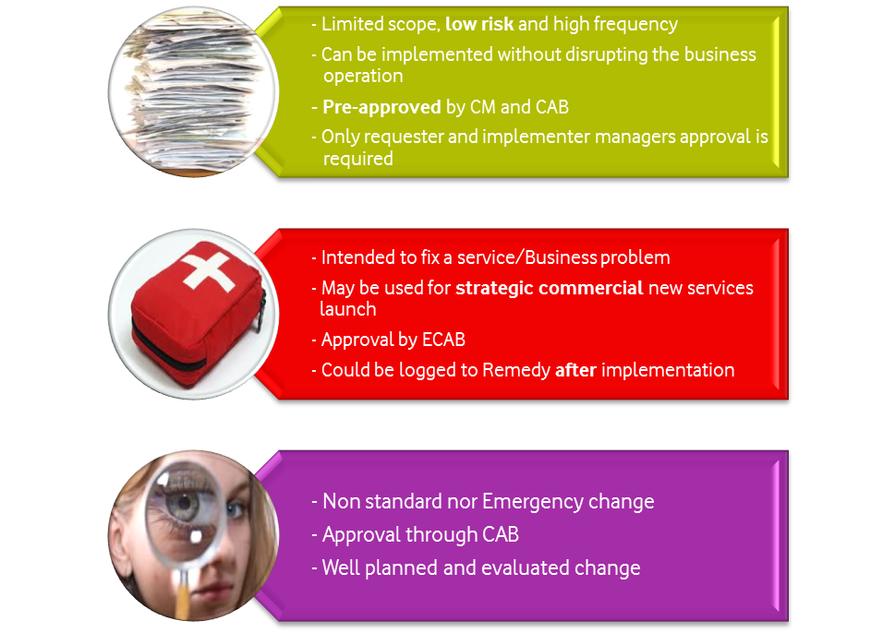



What do we mean by a Change?
Any change implemented that might affect directly or indirectly any of the technology production services, systems and applications this shall include
New services/systems roll out
Patch deployment
System upgrades
Software new releases
Hardware upgrades & maintenance
Software fixes and updates
New feature deployments
Incident and problem management related changes
Power scheduled maintenance impacting technology services
Capacity related modifications
Support and Maintenance activities including emergency actions
Standard
Emergency
Normal

Slide 5

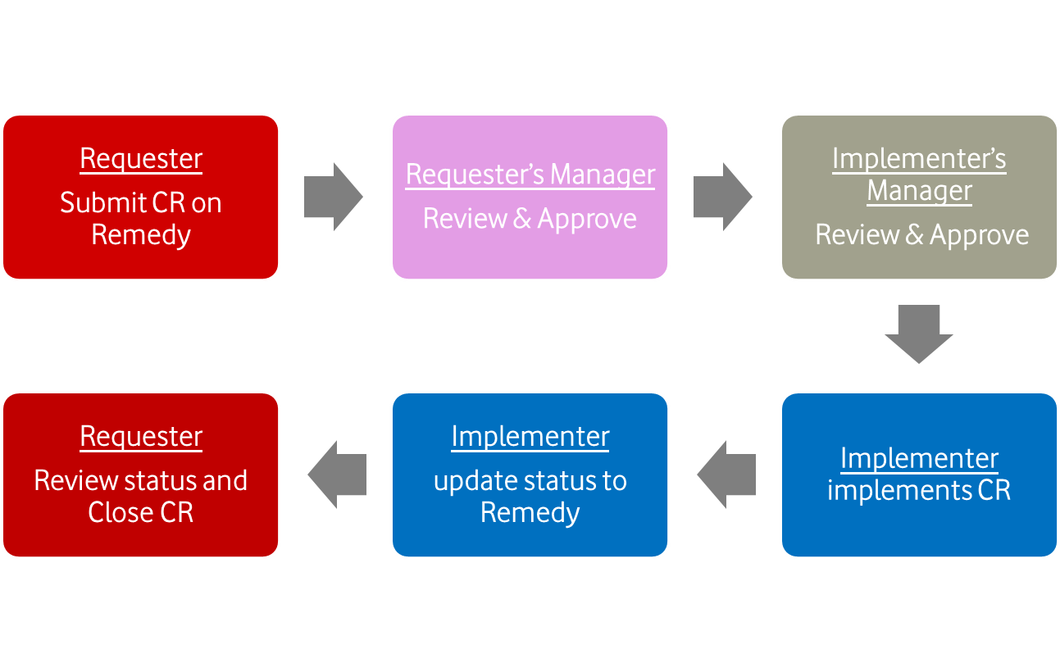

Process Flow?
Standard Change

Slide 6

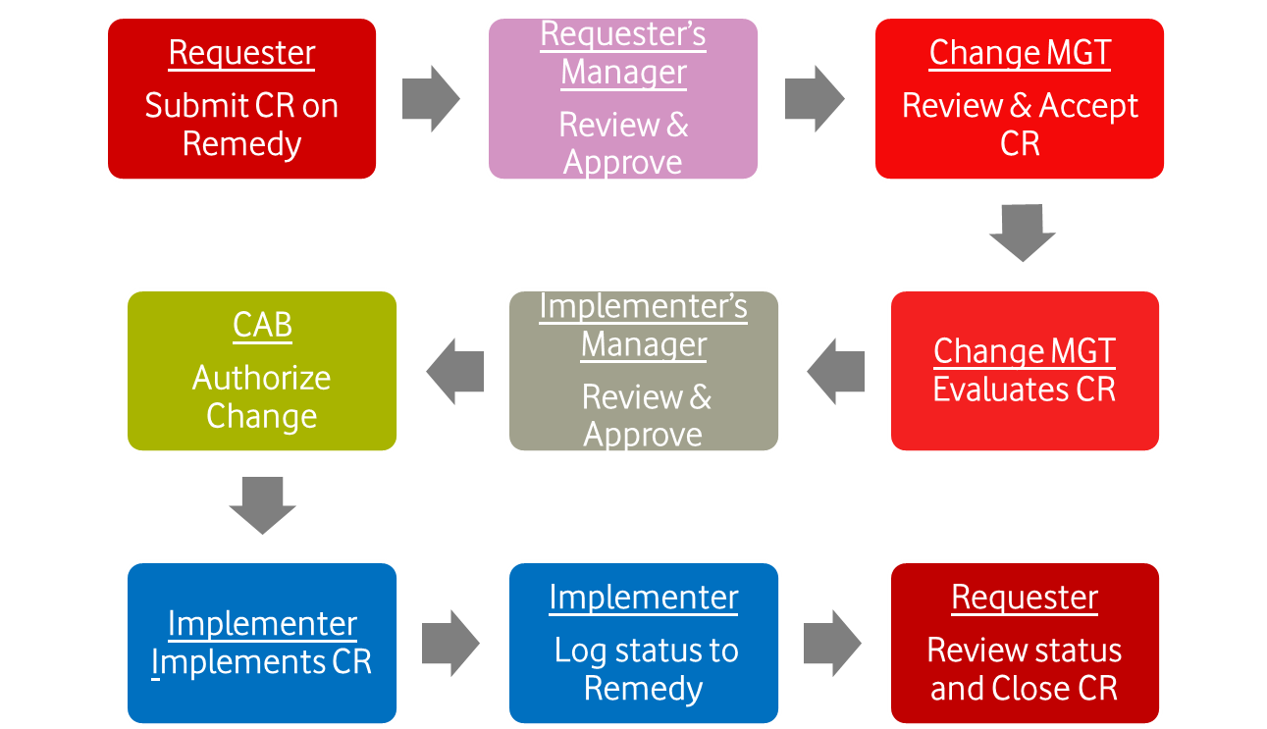
Process Flow? (Cont.)
Normal Change

Slide 7

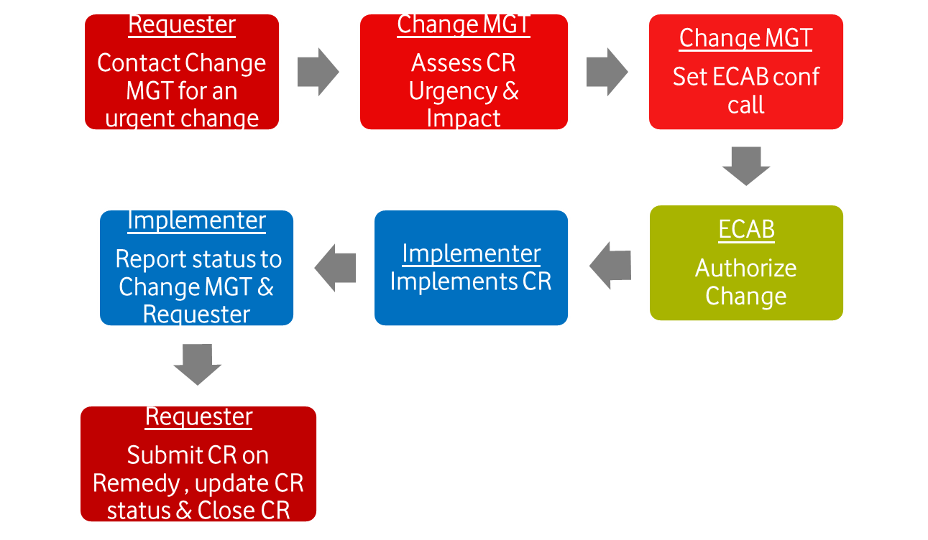

Process Flow? (Cont.)
Emergency Change

Slide 8
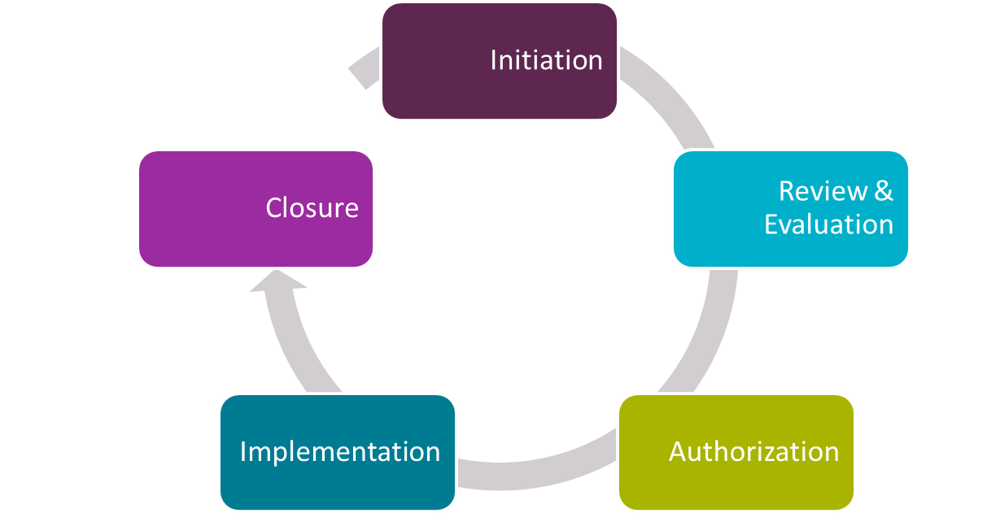







Change requester submits a CR on Remedy
Requester’s manager evaluate the CR and confirms it is technically valid
CR goes to CM
CR Phases….
Change requester evaluates implementation report to declare change success/failure
CM review mandatory fields in CR
CM evaluates CR, Urgency , Impact
Implementer evaluates request
CAB meeting for Normal changes
Pre- approval automated workflow for standard changes
ECAB of Senior Mgt level over a conference call for Emergency changes
Remedy tasks assigned to implementation teams
Implementer updates the status on Remedy
Post implementation testing

Slide 9

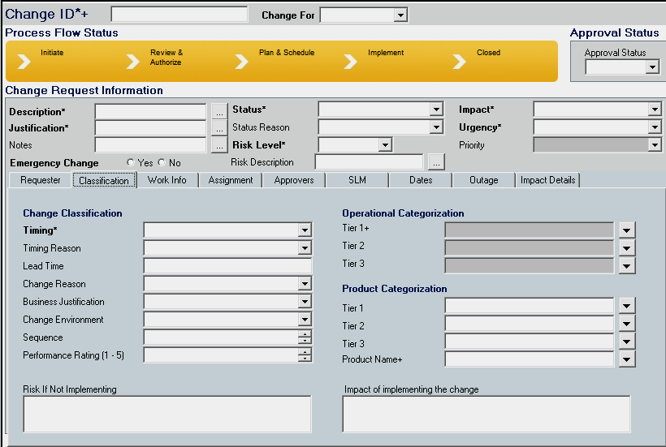
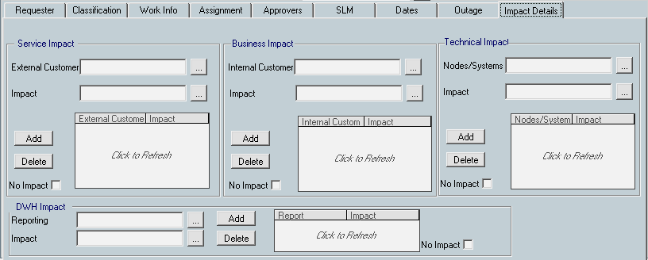


Remedy Mandatory Fields
Mandatory Fields
  Description
  Justification
  Impacted services
  Business Impact
  Technical Impact
  Urgency Level
  Impact Level
  Risk Level
  Proposed Date/ Time
  Proposed change priority
  Pre-implementation testing
  Post implementation testing
  Roll back plan
  Implementation plan

Slide 10


Zooming In Some
Mandatory Fields
  Impact
  Urgency
  Priority
  Risk
Insert Confidentiality level | 7 November 2026

Slide 11


Impact….
Impact | CAB autorization | Subscribers | VAS customer base | Sites | Risk revenue | IT
Extensive | Required | >= 25% | >= 1% | >= 100 sites | >= EGP 250K | Impacts multiple services/ systems.. A “Mission critical” service impact
Significant | Required | >= 15% and <25% | >= 0.5% and <1% | >= 50 and <100 sites | >= EGP 51K and < EGP 250K | Affecting a complete business unit A “Business critical” service impact
Moderate | Not Req. | >= 10% and <15% | < 0.5% | >= 10 sites and <50 sites | > EGP 1K and < EGP 51K | Affecting a small number of individuals A “Business important” service impact
Minor | Not Req. |  | Any impact less than the above

Slide 12

Urgency….
Urgency | Time frame | Description
Critical | Quickly | To recover an unavailable service To deploy a commercial strategic roll out
High | Quickly | To recover certain functions of a service unavailable for the customer
Medium | Appropriate | To recover a service that is not severely impacted New Service Deployment Upgrade Service or enhance service
Low | Appropriate | To recover certain service functions that are degraded but still available
According to the Impact and Urgency chosen the Priority is set according to this equation
Priority = Impact X Urgency

Slide 13

Impact X Urgency =
Priority |  | Impact
 |  | Extensive | Significant | Moderate | Minor
Urgency | Critical | Critical | Critical | High | Medium
 | High | Critical | High | Medium | Medium
 | Medium | High | Medium | Medium | Low
 | Low | Medium | Medium | Low | Low
Priority matrix:
Impact X Urgency
Priority | Description | Authorization | Resources
Critical | Immediate action required | ECAB authorization | resources allocated immediately in < 12 hours
High | Accepting business and technical risks | CAB/ECAB authorization | resources allocated immediately in < 24 hours
Medium | Scheduling is required to ensure coordination between groups, management commitment of resources, CAB
Low | The Change is made available for review to ensure general awareness and alignment

Slide 14

Risk ….
Change risk assessment should be conducted by the change management team to identify the level of risk associated with the requested change
Risk Level | Impact | Probability
Level 1 | No service impact
Level 2 | Low | Low
Level 3 | Low | High
Level 4 | High | Low
Level 5 | High | High

Slide 15

What’s required from your side ?
Strictly follow the CM Process.
Submit all changes through Remedy.
Make sure all Remedy fields are accurate and descriptive.
Implement only fully approved changes.
Apply pre & post testing scenarios.
Update/Close tasks and CRs.
All Changes to be submitted and approved by requester’s manager before 2:00 PM
Vodafone advertising (INTERNAL OR EXTERNAL USE)
Insert Confidentiality level | 7 November 2026

Slide 16

Questions

Slide 17
Thank You

